Slide 1
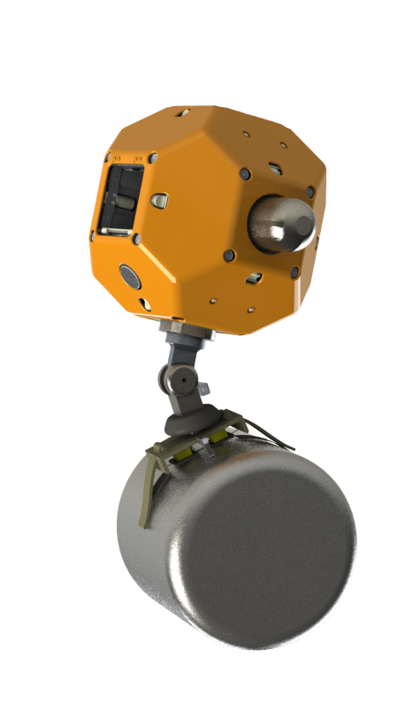
Control of an Active Wrist for a Gecko-Inspired Adhesive Gripper
Negin Heravi, Matt Estrada
Stanford University
September 26, 2017

Slide 2
Project Goal
use active control to take into account our model on adhesion limitations.
2

Slide 3
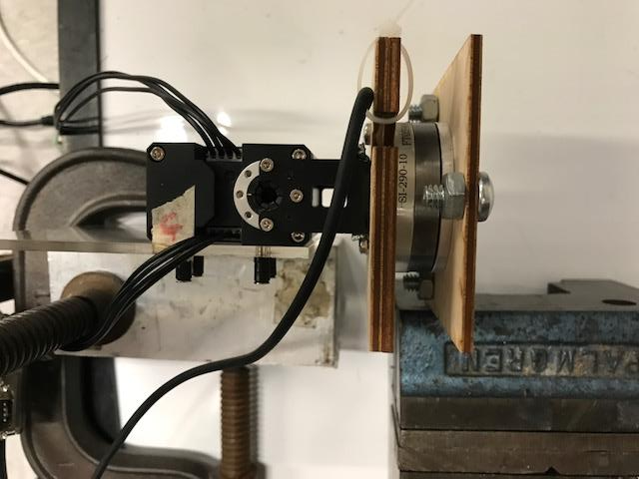
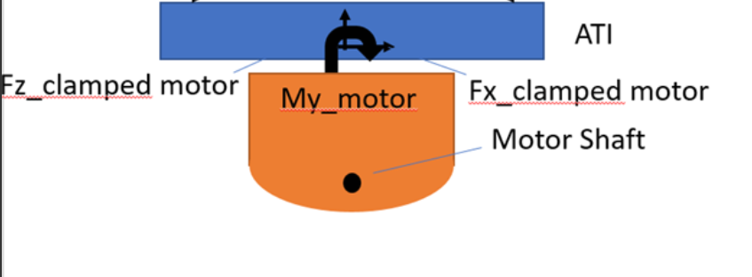
Dynamixel Current control – Set up
System is Grounded
* Dynamixel is what In Won is using so it will port to Astrobee well.
* Both the ATI and the motor are being controller in Visual C++
running on Windows
3

Slide 4
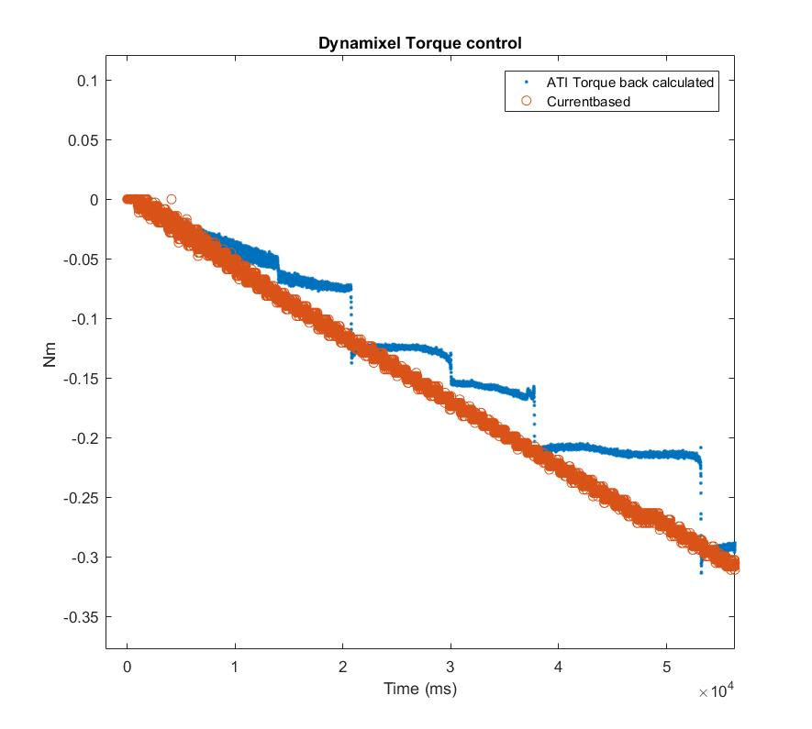
Dynamixel Current control
* There seems to be unexplained jumps in ATI data
4

Slide 5
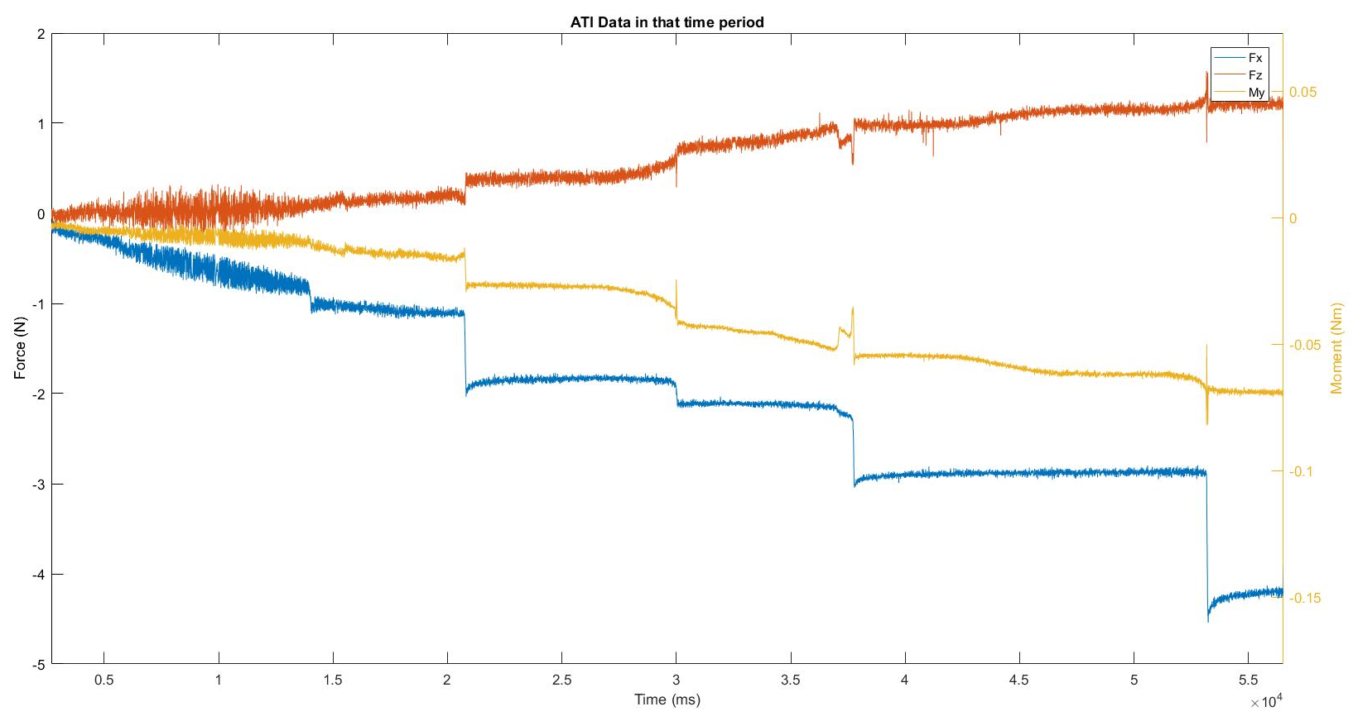
Dynamixel Current control
F_{x}
M_{y}
F_{z}
* Despite the continuous commanded torque, sensor data seem chunked.
5

Slide 6
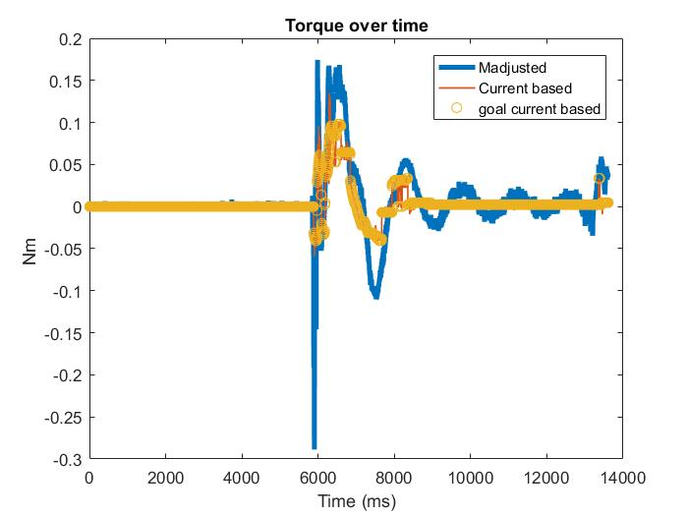
Impedance control with only Spring/Damper Term
6
Current based = Current Register of the motor
Goal Current based= Commanded Desired Current

Slide 7
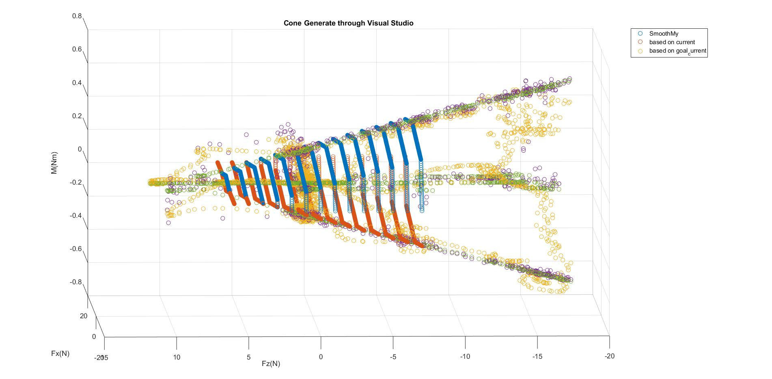
Commanding Torque at Adhesion Limits
Object was moved around by hand
7

Slide 8
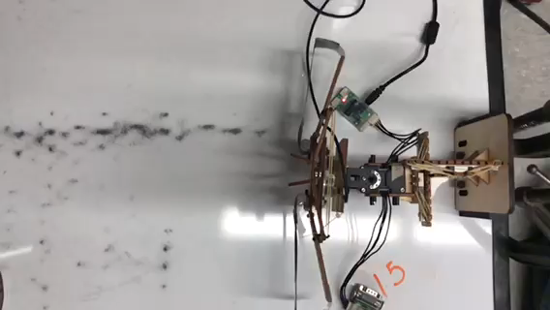
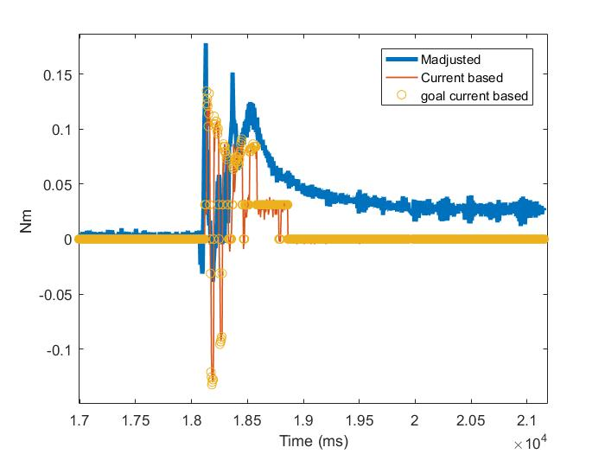
Torque Data Match in Catching
Bistable Collapse
Controller Off
8
Notes:
Trial 15

Slide 9
Extra
9

Slide 10
EOM
To be added
10

Slide 11
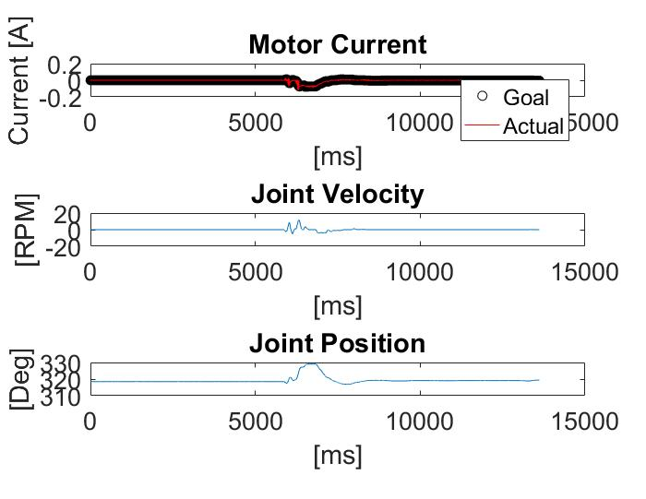
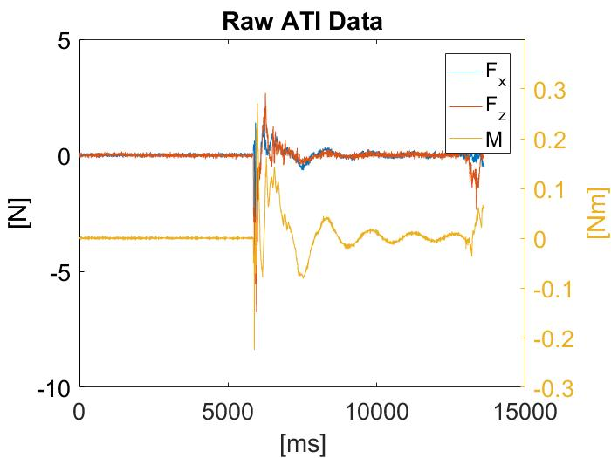
PD control- Extra slide
11

Slide 12
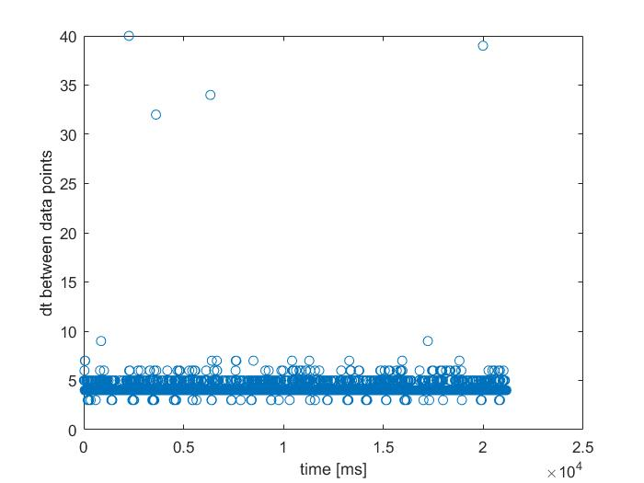
Extra slide
12

Slide 13
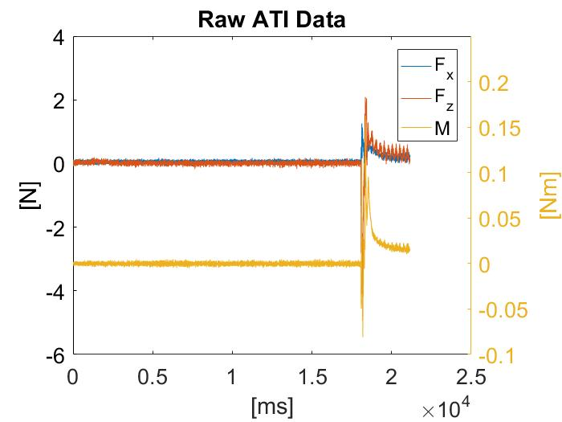
Extra slides
13

Slide 14
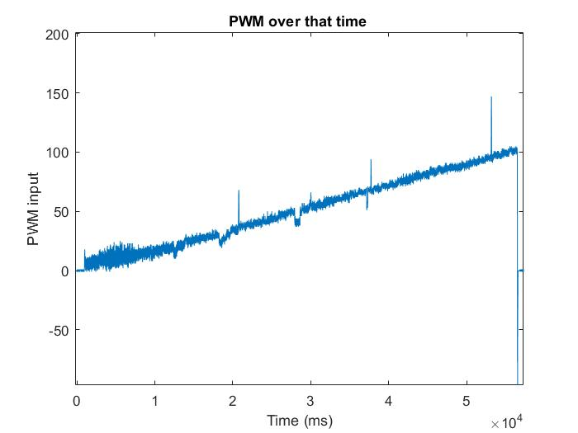
Dynamixel Current control
* The jumps seem to be correlated to jumps in PWM data.
14

Slide 15
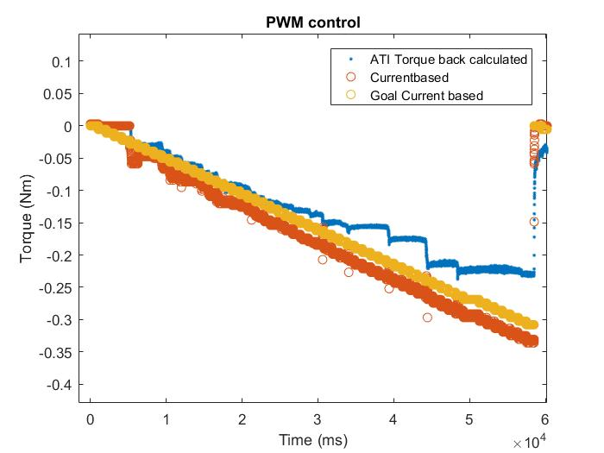
PWM control
* To assess the source of the problem the motor was run in PWM control and a similar problem
was observed ….. //Fix this no goal current ….
15

Slide 16
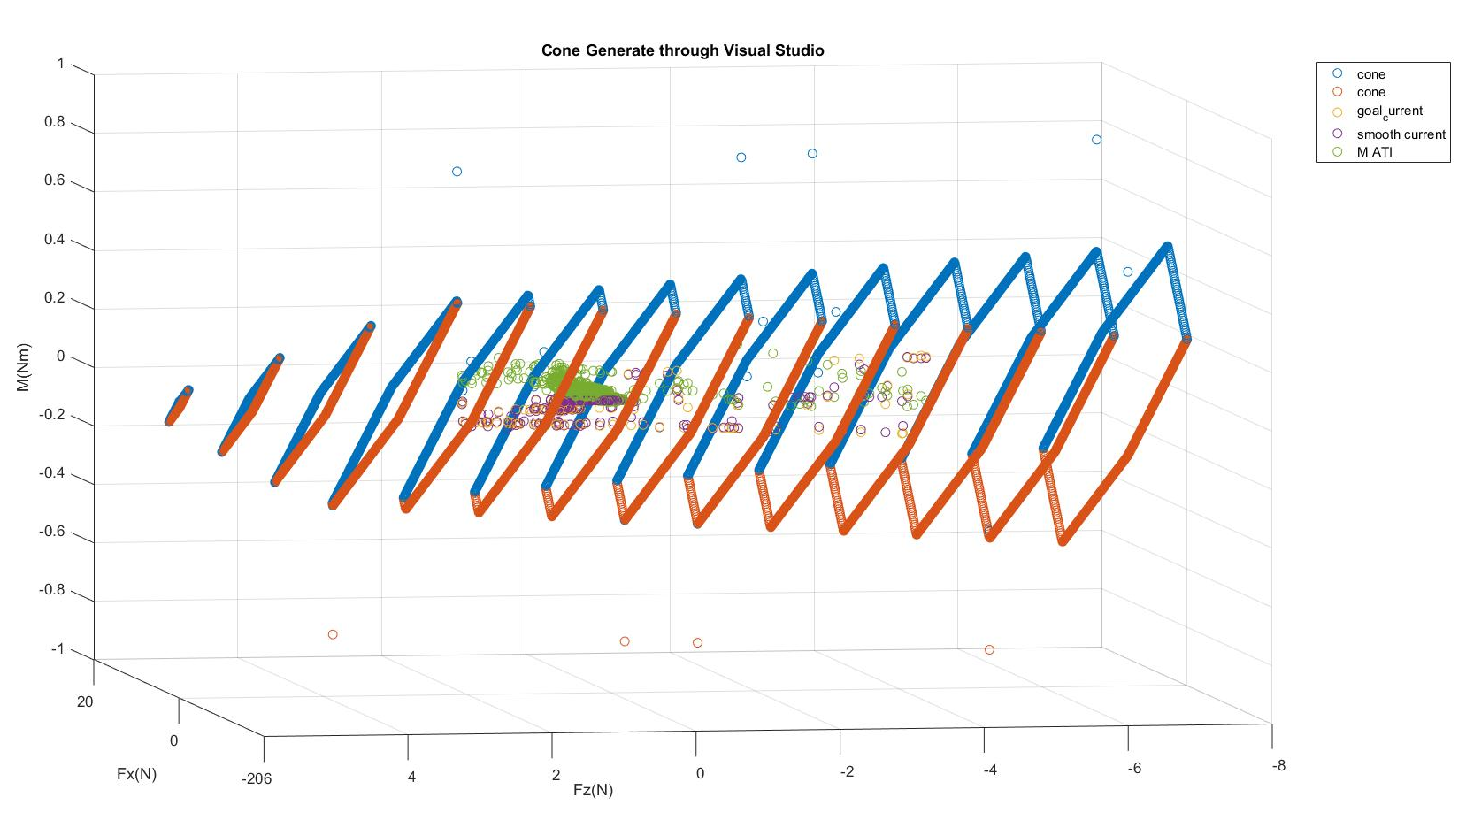
Real Catch Scenario
80 % seems like a reasonable safety factor (this is very hand-wavy) more extensive study should be done
to have a definite number.
16

Slide 17
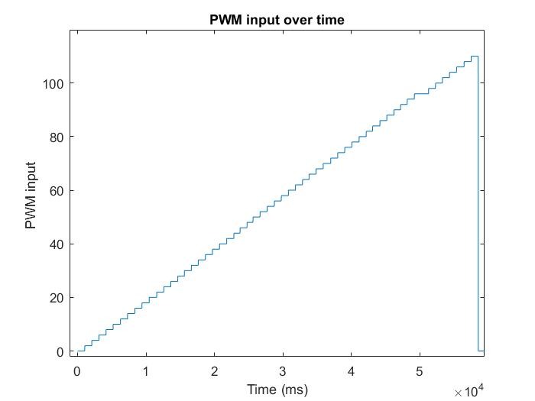
Dynamixel Current control
* Currently talking with the company to find the source of the problem
* Maybe the motor is somehow getting stuck?
17

